Slide 1
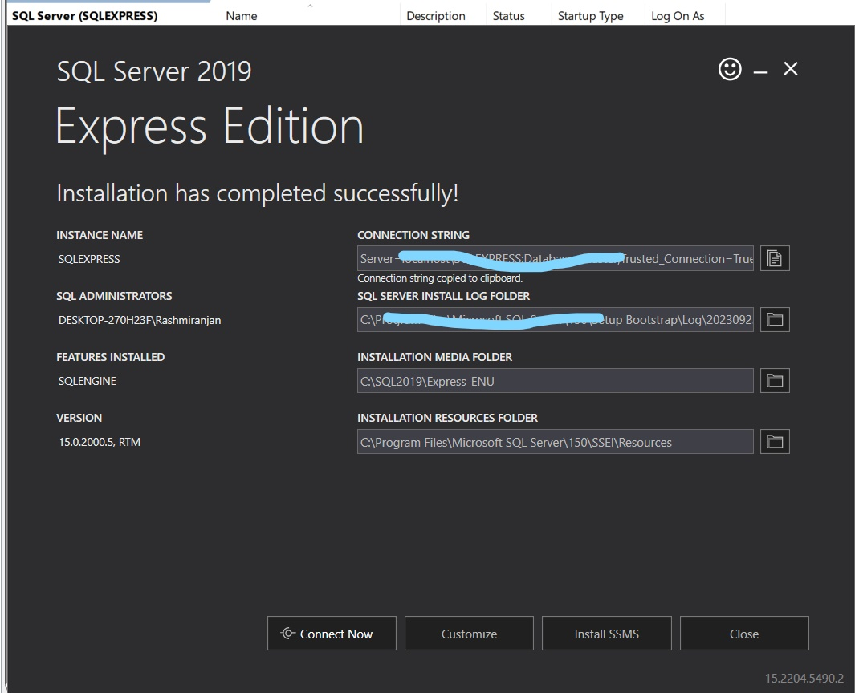
We can directly connect with data lake gen2 through power bi
But As my free trial expire I have to do this
SQL server express edition is a free edition of Microsoft sql server
After installing it creates a local server on our machine
Then we connect this server with SSMS (sql server management service)
Create data base and upload modeled data as table
To find the server details
Search services in windows search bar

Slide 2
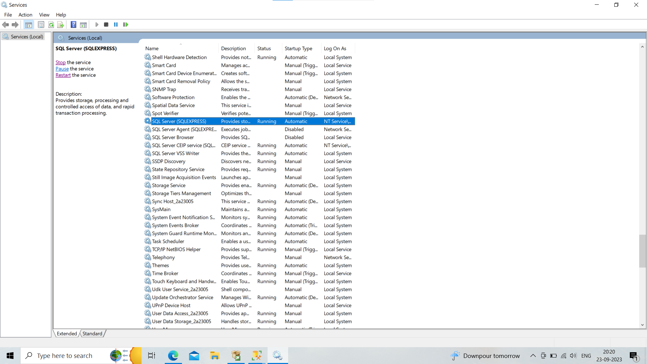

Slide 3
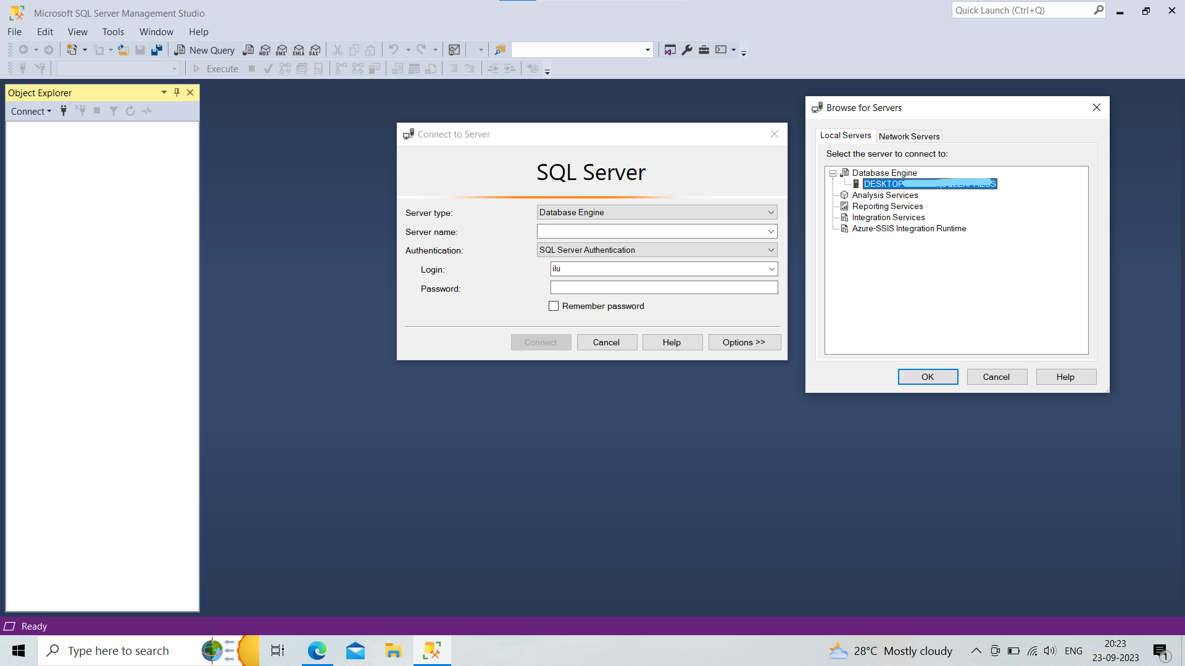

Slide 4
Click on connect icon right to connect
server type = database engine
Server name
click on v icon
To see the servers available
In local servers
Click on database engine
Select the one
In authentication
Select windows authentication
it will direct connect to database
Click connect

Slide 5
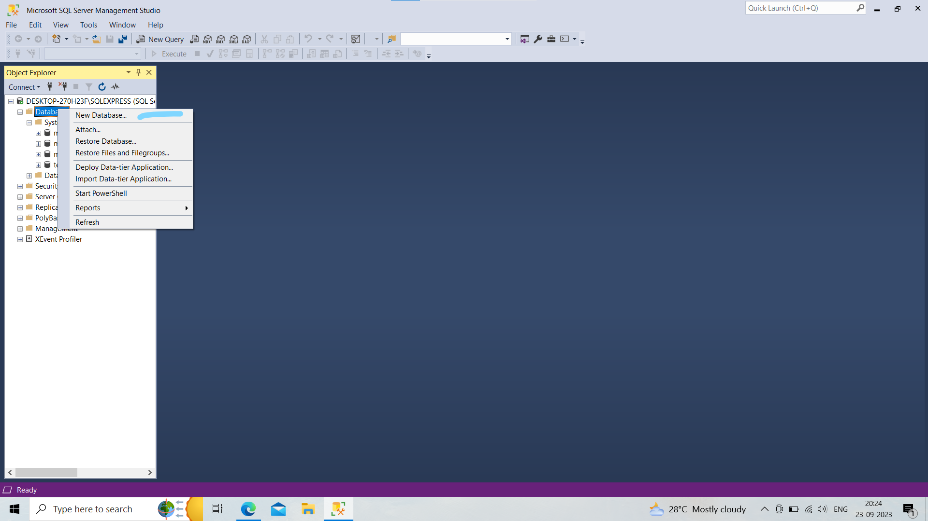
Right Click on database
To create a new database
Name it nyc-tlc-data

Slide 6
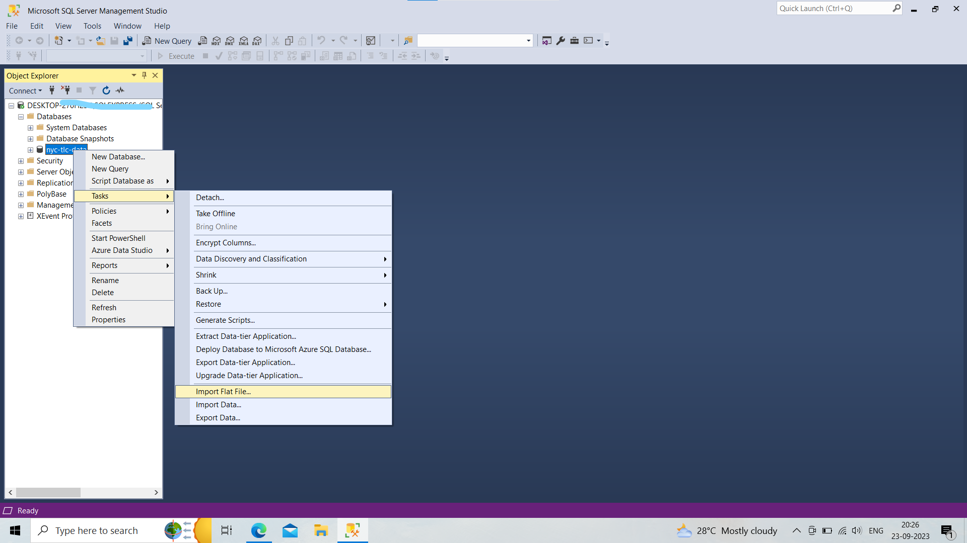
Right click on the database of nyc-tlc-data
Click on tasks
Import flat files as our data file format is csv

Slide 7
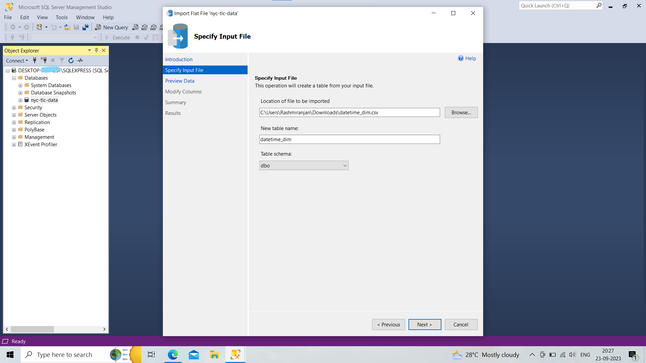
Click on browse
Select the file
Table name
next

Slide 8
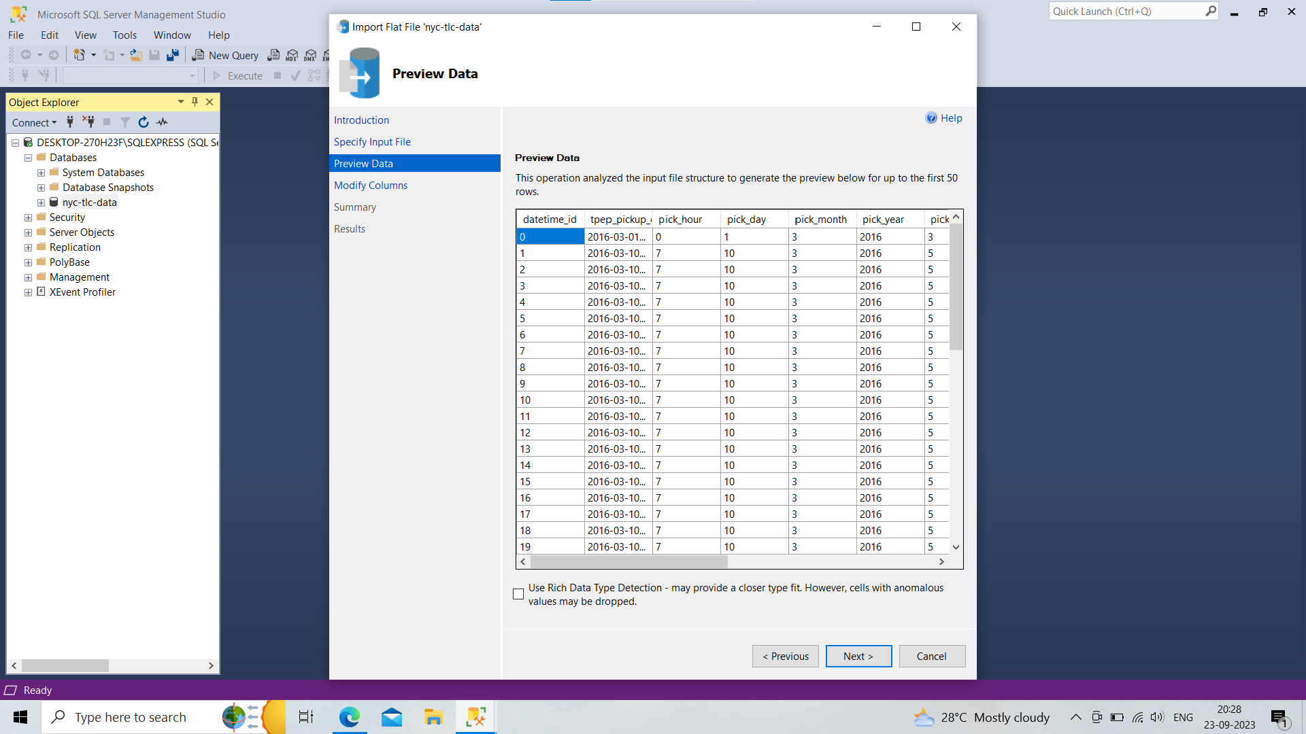
Previewing data
Next

Slide 9
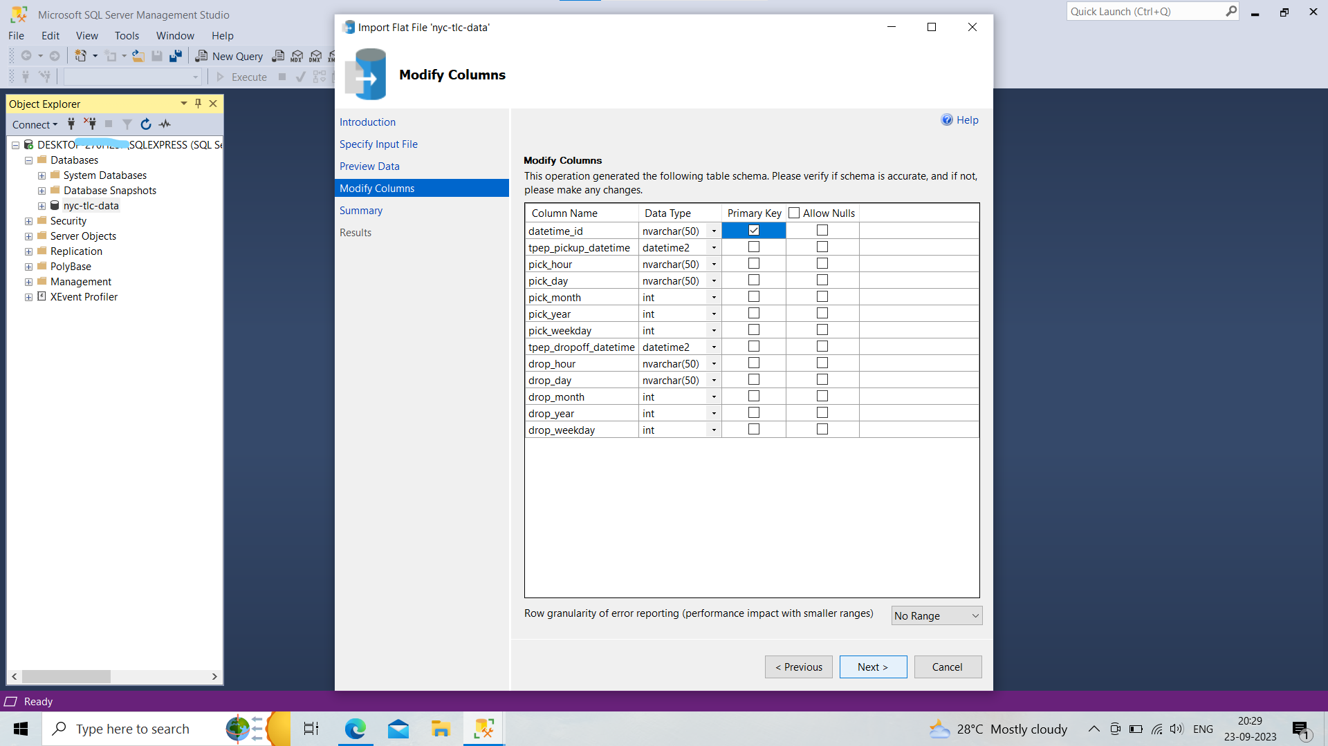
Check the data type and convert into correct data type
Set primary keys
Next ,next done

Slide 10
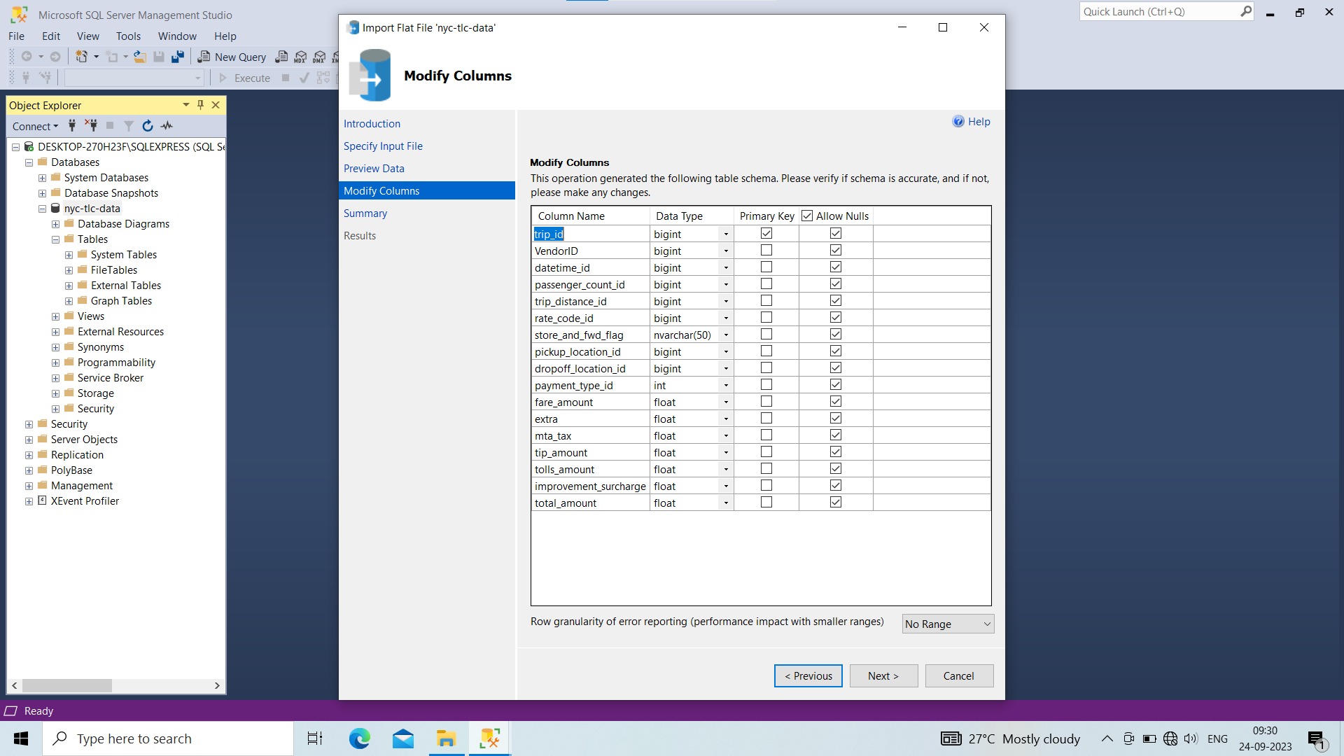
Doing same procedure for all files

Slide 11
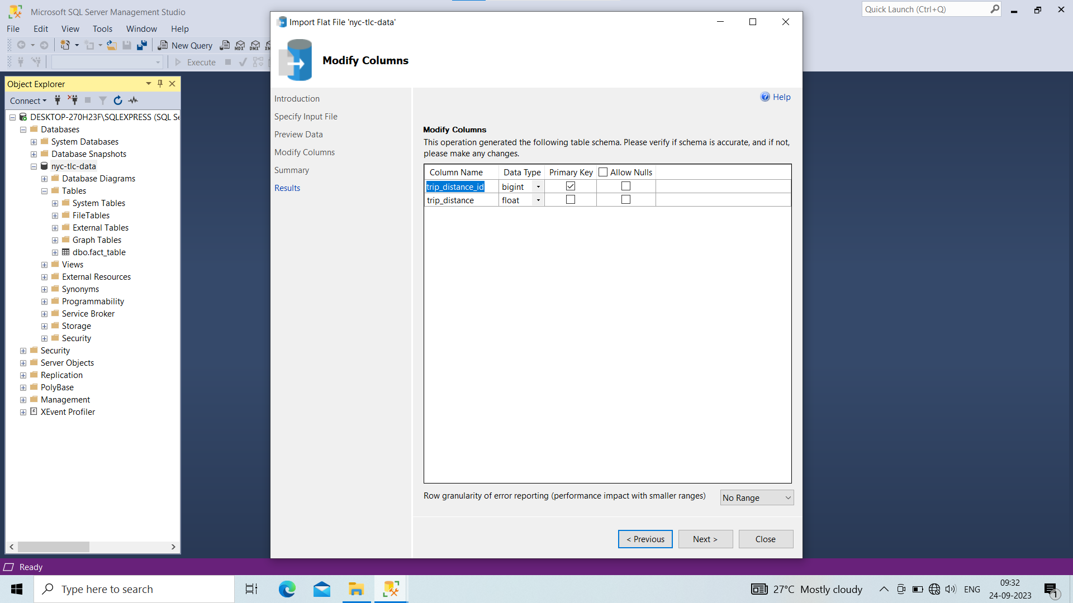

Slide 12
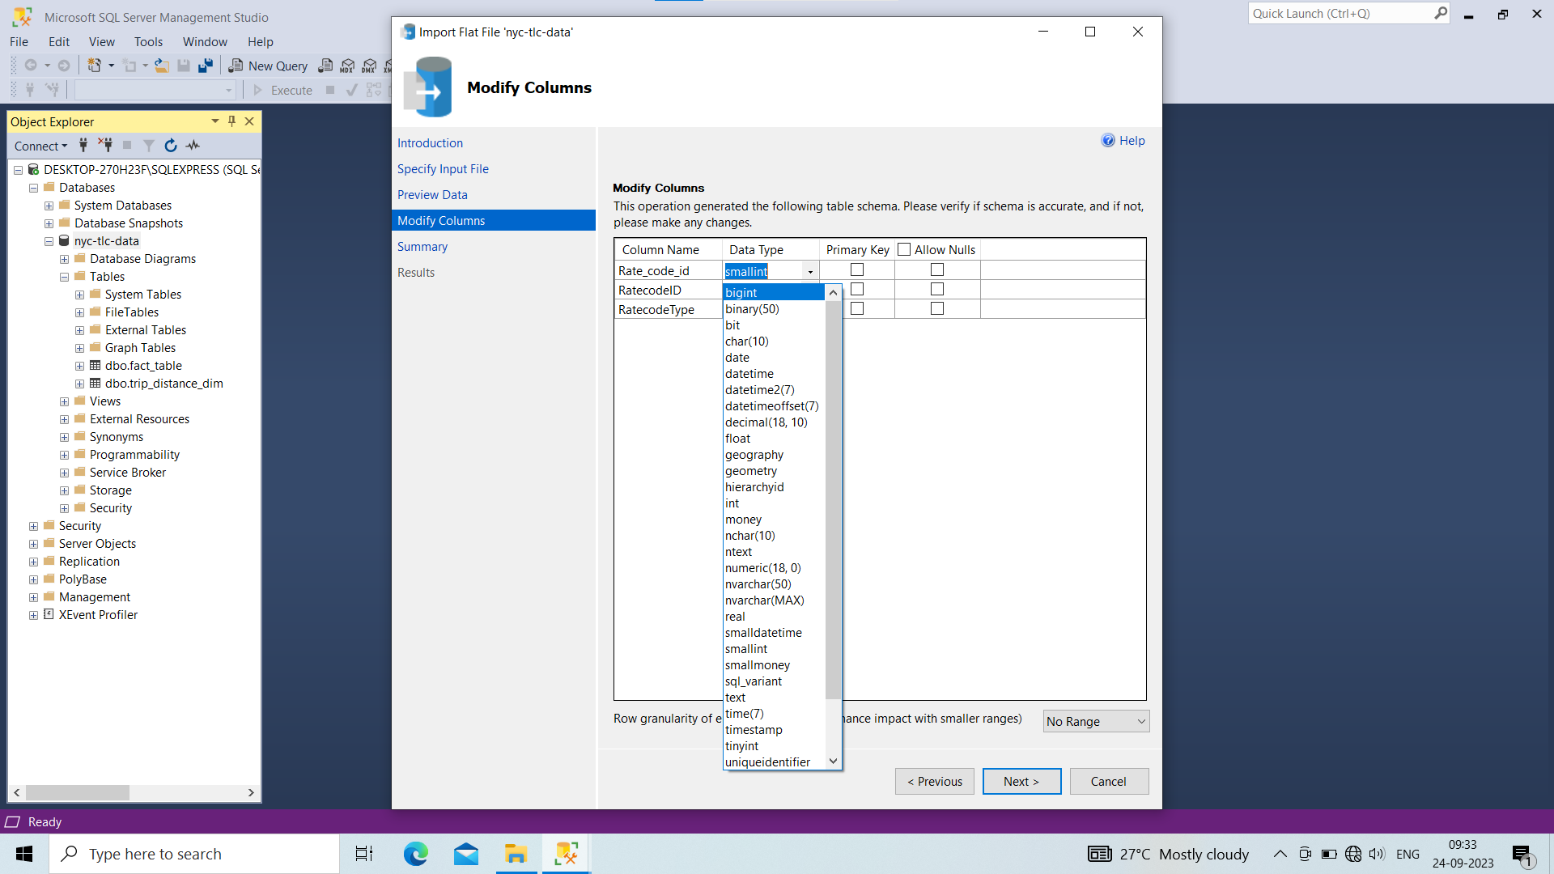

Slide 13


Slide 14


Slide 15
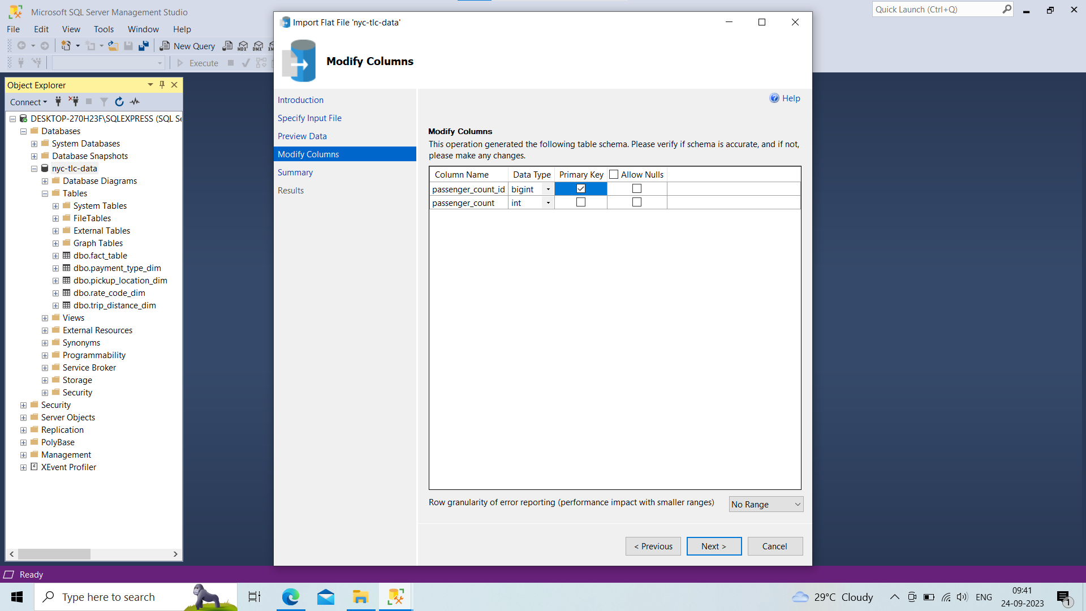

Slide 16


Slide 17
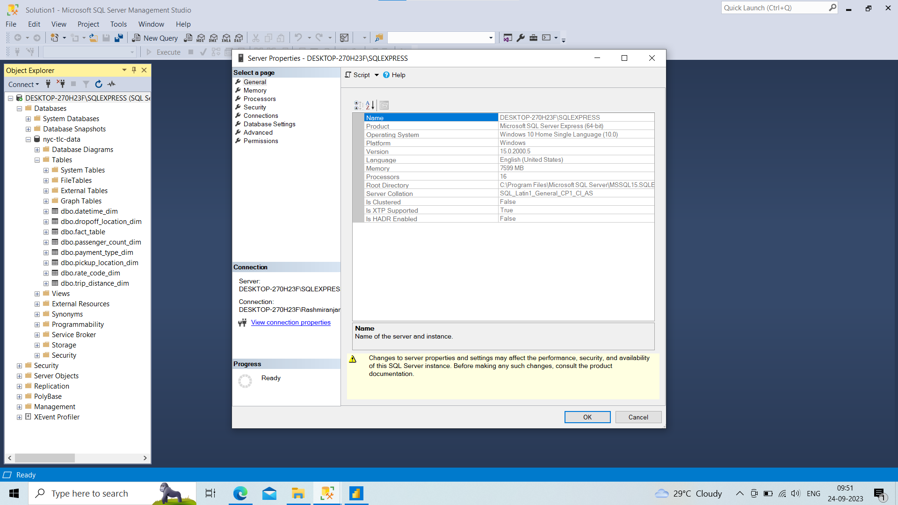
Right click on server name
See properties
Copy server name

Slide 18
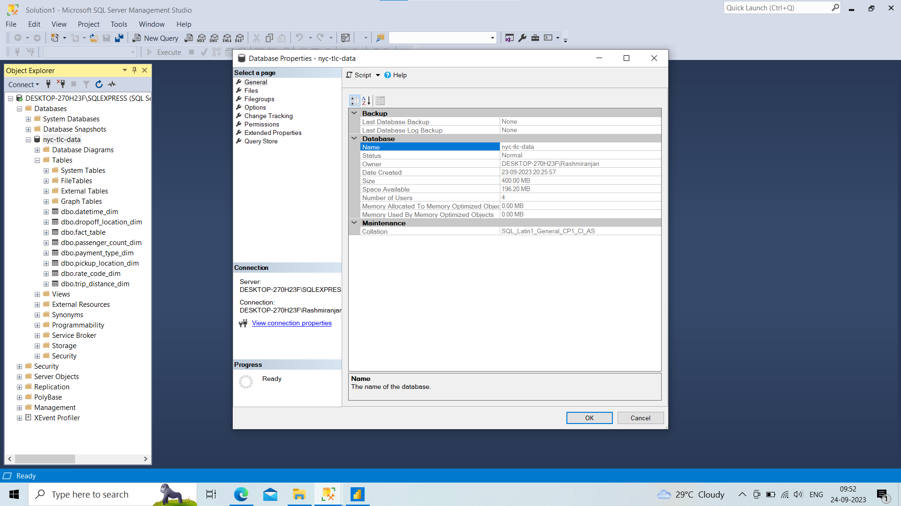
Right click on database
See properties
Copy database name to connect with power bi

Slide 19
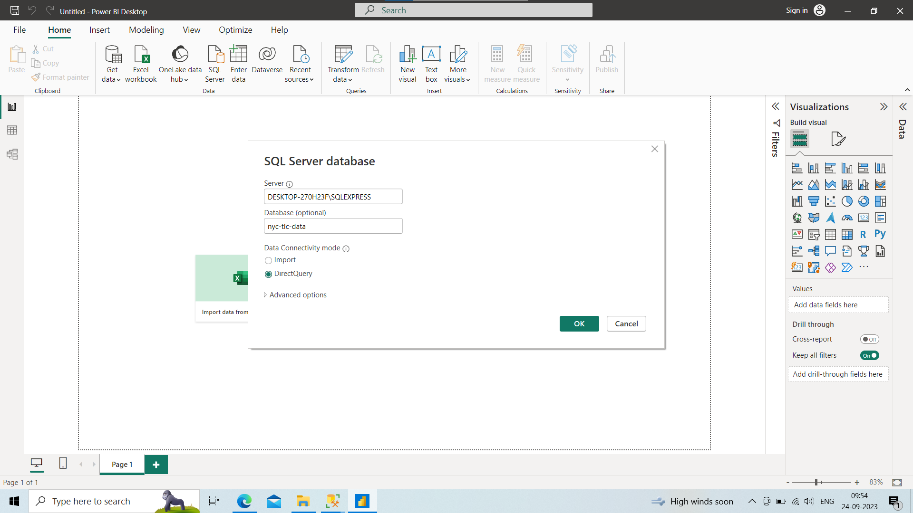
Click on get data
Select sql server provide details
Select direct query

